Slide 1


Digital Logic and Design

Slide 2


Slides can be found at
https://github.com/sajjo79/Digital-Logic-Design

Slide 3
Storage Elements: Other Flipflops
Chapter 4: FlipFlops

Slide 4
Introduction
VLSI circuits contains millions of gates within one pack
To form a digital circuit, gates are interconnected
A flip-flop is also constructed by interconnecting multiple gates
Edge triggered D flip flop requires minimum number of gates hence economical
Using D flip flop and external logic, other flip flops can be constructed
Other less widely used flipflops are
JK flipflop and T flip flop

Slide 5
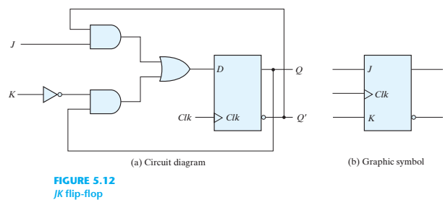
JK Flip-Flop
Following 3 operations are performed by a flip-flop
Set to 1, set to zero, complement the output
With one input, D flip-flop can set or reset the output
JK flip flop has two inputs and can perform all three operations
The J-input sets the flip-flop to 1
K-input resets the flip-flop to 0
Both inputs at the same time complements the output

Slide 6
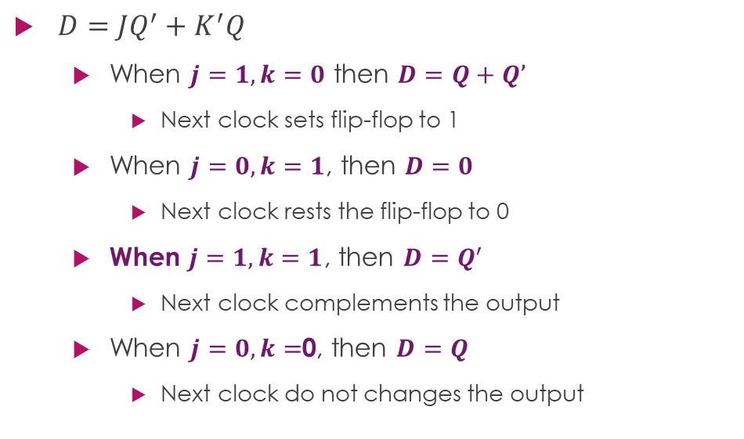
Operations of Flip-flops
$D=JQ^{′}+K^{′}Q$
When $j=1,k=0$ then $D=Q+Q’$
Next clock sets flip-flop to 1
When $j=0,k=1$, then $D=0$
Next clock rests the flip-flop to 0
When $j=1,k=1$, then $D=Q^{′}$
Next clock complements the output
When $j=0,k=$0, then $D=Q$
Next clock do not changes the output

Slide 7
T (toggle) Flip-Flop
T flip-flop is a modified form of JK flip-flop

Slide 8
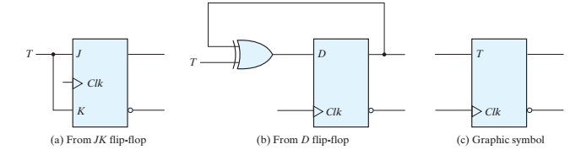
T Flip-Flop
It is also called a complementing flip-flop
Complementing FF is useful for designing binary counters
T-FF can also be constructed using D-FF
T | J | K | Q
0 | 0 | 0 | Clock edge does not change the output Q
1 | 1 | 1 | Clock edge complements the output Q

Slide 9
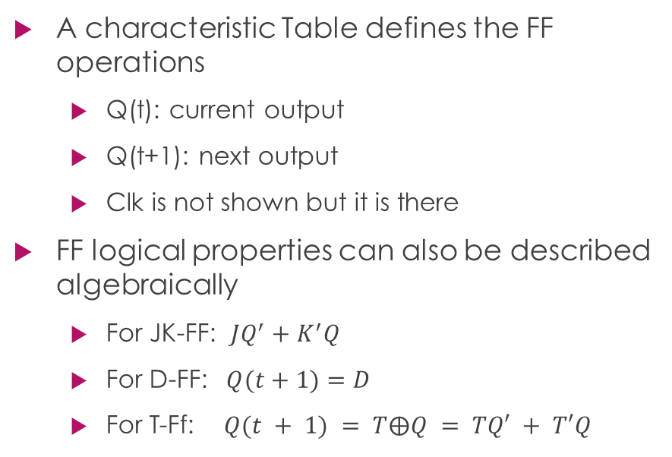
Characteristic Tables
A characteristic Table defines the FF operations
Q(t): current output
Q(t+1): next output
Clk is not shown but it is there
FF logical properties can also be described algebraically
For JK-FF: $JQ^{′}+K^{′}Q$
For D-FF: $Q(t+1)=D$
For T-Ff: $Q(t + 1) = T⨁Q = TQ′ + T′Q$
J | K | Q(t+1) | Comments
0 | 0 | Q(t) | No change
0 | 1 | 0 | Reset
1 | 0 | 1 | Set
1 | 1 | Q’(t) | Complement
JK Flip-Flop
D | Q(t+1) | Comments
0 | 0 | Reset
1 | 1 | Set
D Flip-Flop
T | Q(t+1) | Comments
0 | Q(t) | No Change
1 | Q’(t) | Complement
T Flip-Flop

Slide 10
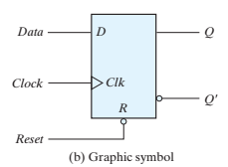
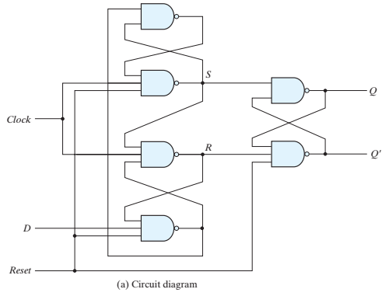
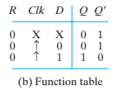
Direct inputs
Some flip-flops use asynchronous inputs
These inputs produced a particular state of FF, independent of clock
Preset or direct set inputs: the inputs that set the state of FF
Clear or direct rest inputs: the inputs that reset the state of FF
When power is supplied to FF, its states are unknown
Direct inputs are useful to bring the flip flops to known states prior to clock operation

Slide 11
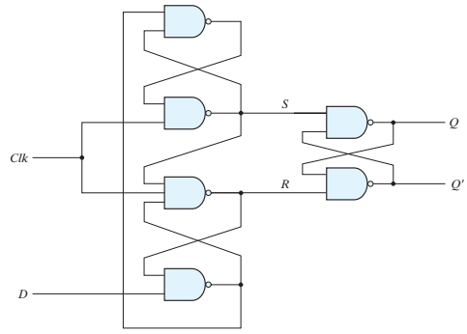

Slide 12
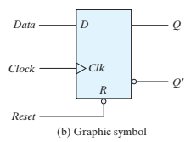
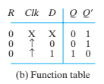
Both figures are same except an additional reset signal to 3 NAND gates
If reset=0, Q’=1 and Q=0, FF-rest
Two other connections from the reset input ensure that the S input of the third SR latch stays at logic 1 while the reset input is at 0, regardless of the values of D and Clk
In graphical symbol, the reset is indicated with R
If R=0, output is reset to 0 independent of D or Clk.
If R=1, normal clock operation proceeds
Clk with upwards arrow indicates that flip-flop triggers on the positive edge of the clock
Value of D is transferred to Q only when R=1

Slide 13
13
Thanks for watching
Dr. Sajid Iqbal
Assistant Professor
Department of Computer Science
Bahauddin Zakariya University, Multan
Allah Hafiz
Slides are available at: https://github.com/sajjo79/Digital-Logic-Design

